Slide 1

EE-371 : Control Systems
Lecture#25, 26
7.5 Steady-State Error for Disturbances
7.6 Steady-State Error for Non unity
Feedback Systems
7.7 Sensitivity
Textbook: Chapter # 07 (5th edition)
Text Book: Control Systems Engineering by Norman S. Nise 5th Edition
Instructor: Ms Neelma Naz
Class: BEE 12 C/D
School of Electrical Engineering and Computer Science
Department of Electrical Engineering

Slide 2
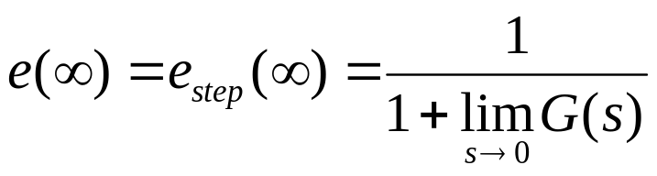
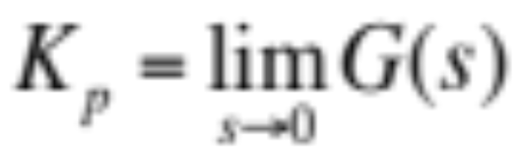
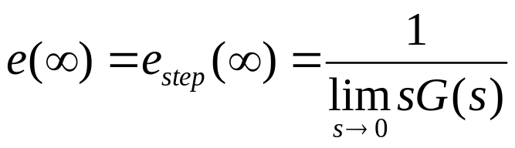
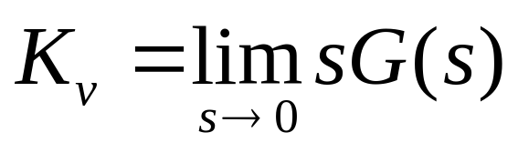
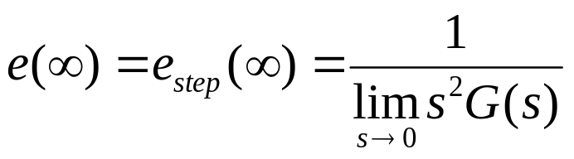
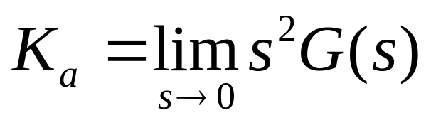
Static Error Constants
The three terms in the denominator that are taken to the limit determine the steady-state error.
These limits are the static error constants.
For a step input, u(t),
Position Constant, Kp
For a ramp input, tu(t),
Velocity Constant, Kv
For a parabolic input, ½ t²u(t).
Acceleration Constant, Ka

Slide 3
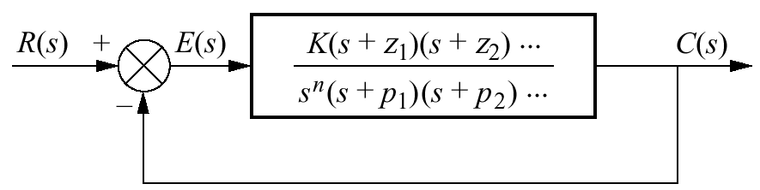
System Type
unity negative feedback systems
Since steady-state errors are dependent upon the number of integrations in the forward path, a name is given to this system attribute
system type is defined to be the value of n in the denominator.
Thus:
a system with n = 0 is a Type 0 system
n = 1 is a Type 1 system
n = 2 is a Type 2 system

Slide 4
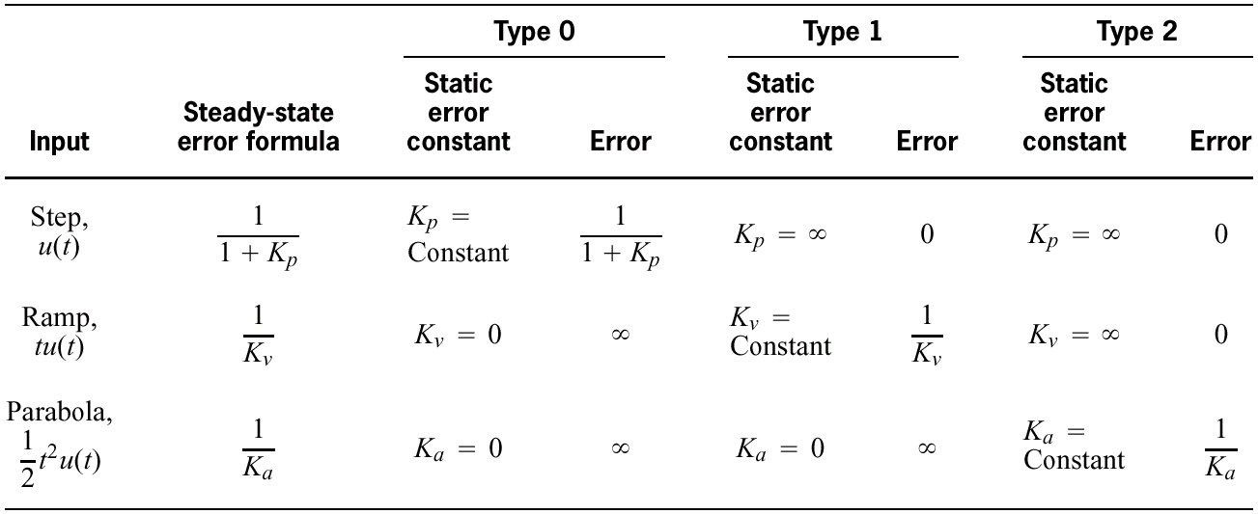
Table 7.2
Relationships between input, system type, static error constants, and steady-state errors

Slide 5
7.4 Steady-State Error Specifications

Slide 6
Just as
damping ratio, ζ
settling time, T_{s}
peak time, T_{p}
percent overshoot, % OS
are used as specifications for a control system's
transient response
Position constant, K_{p}
Velocity constant, K_{v}
Acceleration constant, K_{a}
are used as specifications for a control system's steady-state errors

Slide 7

Wealth of information contained within the specification of a static error constant
For example, if a control system has the specification Kv = 1000,
we can draw several conclusions:
1. The system is stable.
2. The system is of Type 1, since only Type 1 systems have Kv's that are finite constants.
Recall that Kv = 0 for Type 0 systems
Kv = for Type 2 systems
3. A ramp input is the test signal.
Since Kv is specified as a finite constant, and the steady-state error for a ramp input is inversely proportional to K_{v}, we know the test input is a ramp.
4. The steady-state error between the input ramp and the output ramp is 1/K_{v} per unit of input slope.

Slide 8

Example 7.5
Interpreting the Steady-State Error Specification
PROBLEM:
What information is contained in the specification K_{p} = 1000?
SOLUTION:
The system is stable.
The system is Type 0, since only a Type 0 system has a finite K_{p}. Type 1 and Type 2 systems have K_{p} =
The input test signal is a step, since K_{p} is specified.
The error per unit step is

Slide 9
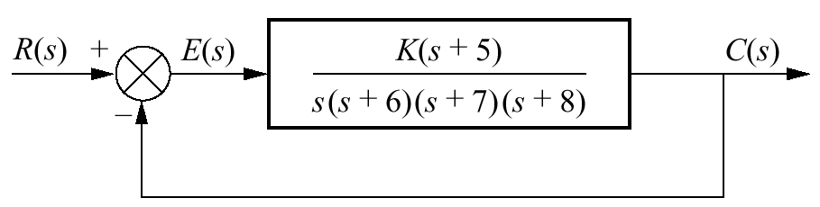



Example 7.6
Gain Design to Meet a Steady-State Error Specification
PROBLEM: Given the control system in the Figure, find the value of K so that there is 10% error in the steady state.
SOLUTION: Since the system is Type 1, the error stated in the problem must apply to a ramp input; only a ramp yields a finite error in a Type 1 system. Thus,

Slide 10
7.5 Steady-State Error for Disturbances

Slide 11
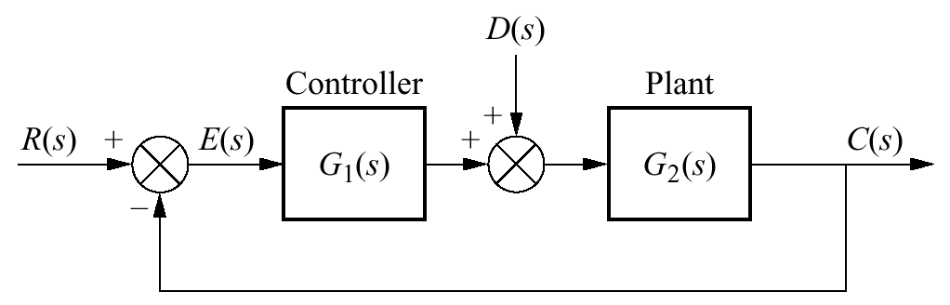

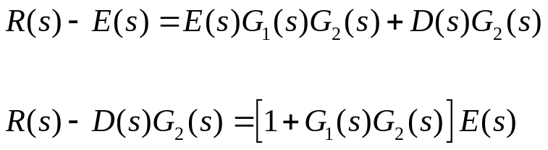
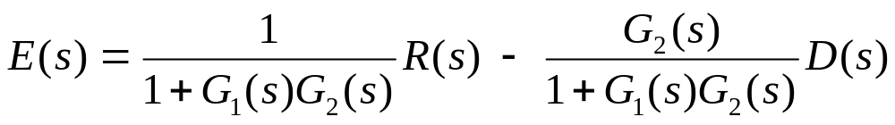
Figure 7.11
Feedback control system showing disturbance
transfer function relating E(s) to D(s)
transfer function relating E(s) to R(s)

Slide 12
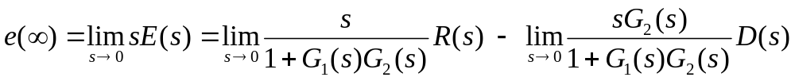
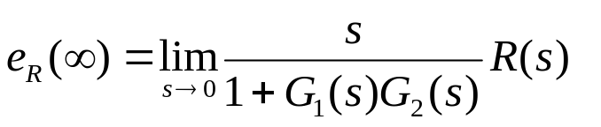
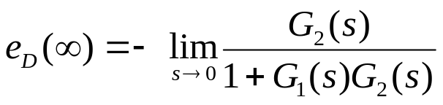
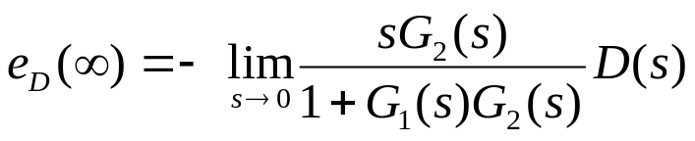
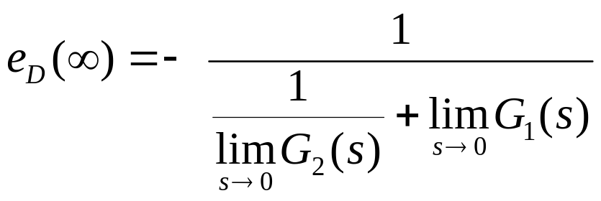

Applying the final value theorem
Assume a step disturbance,
D(s) = 1/s.
Let us explore the conditions on that must exist to reduce the error due to the disturbance

Slide 13
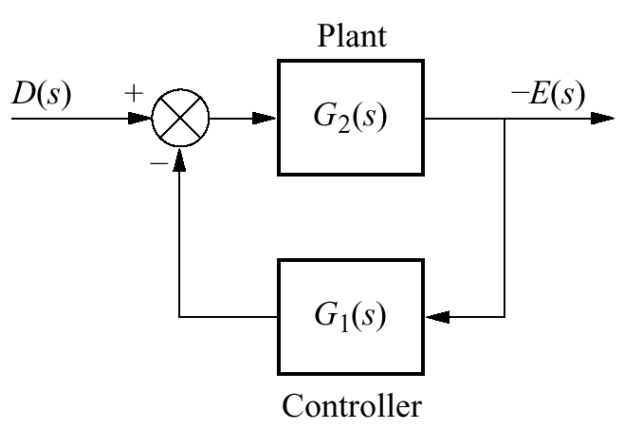
The ss error produced by a step disturbance can be reduced by:
increasing the dc gain of G₁(s)
or
decreasing the dc gain of G₂(s)
System rearranged to show disturbance as
input and error as output, with R(s) = 0

Slide 14
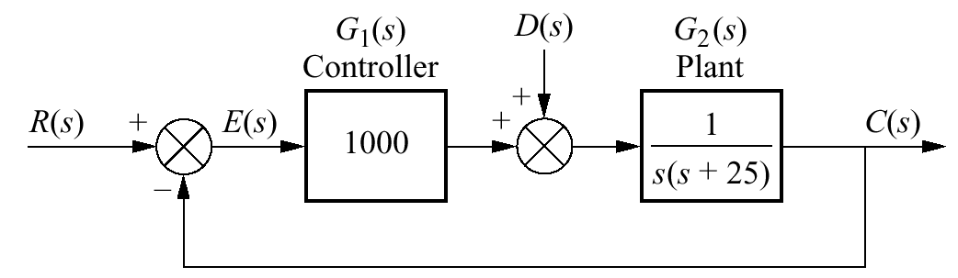
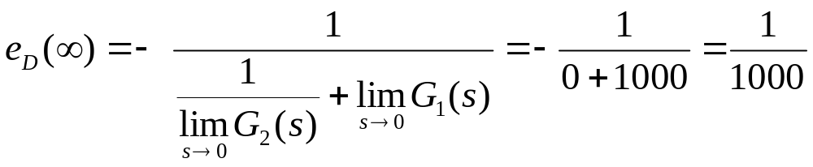
Example 7.7
Steady-State Error Due to Step Disturbance
PROBLEM: Find the steady-state error component due to a step disturbance for the system shown in the Figure.
SOLUTION: The system is stable
the steady-state error produced by the step disturbance is inversely proportional to the dc gain of G₁ (s)

Slide 15
7.6 Steady-State Error for Nonunity Feedback Systems

Slide 16
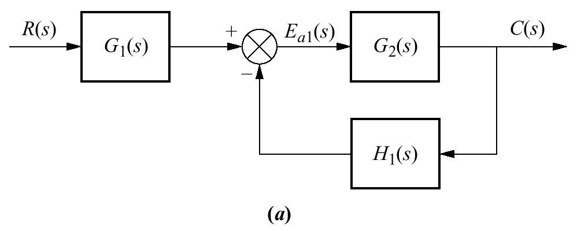
Nonunity Feedback System
The feedback path of a control system may be a pure gain other than unity or may have some dynamic representation
controller and plant
input transducer
Control systems may not have unity feedback
because of the compensation used to improve performance
or
because of the physical model for the system
A general feedback system
feedback
E(s) = R(s) — C(s)
???

Slide 17
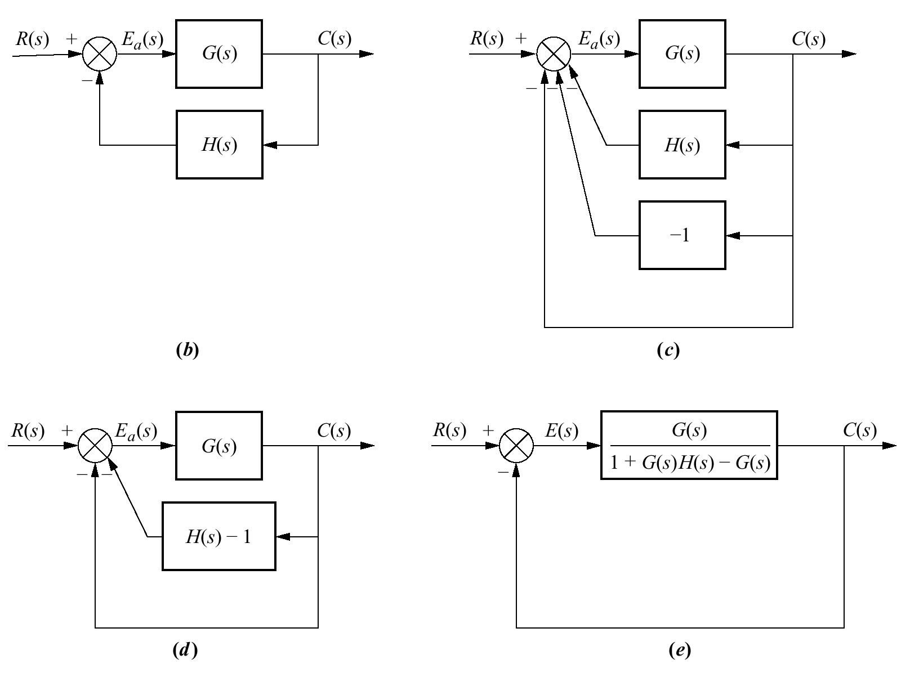
Forming an equivalent unity feedback system from a nonunity feedback system through block diagram manipulation
G(s) = G₁(s)G₂(s)
H(s) = H₁(s)/G₁(s)
The error E_{a}(s) is not the difference between the input and the output
(b)
Actuation signal
Unity Feedback System
E(s) = R(s) — C(s)

Slide 18
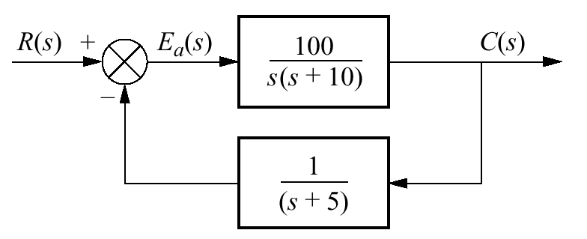






Example 7.8
Steady-State Error for Nonunity Feedback Systems
PROBLEM: For the system shown in the Figure, find the system type, the appropriate error constant associated with the system type, and the steady-state error for a unit step input. Assume input and output units are the same.
SOLUTION:
System Type ???
Convert the system into an equivalent unity feedback system
static error constant
The steady-state error
System Type ???

Slide 19
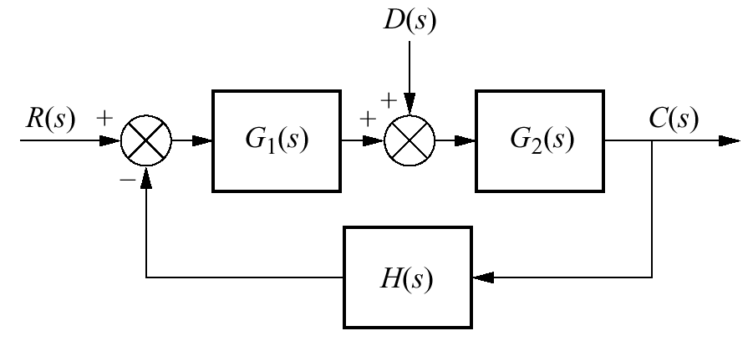






Deriving a general equation for the steady-state error of a system with disturbance and nonunity feedback
For zero error,
Assuming step inputs and step disturbances
The two equations can be satisfied if
(1) the system is stable,
(2) G1(s) is a Type 1 system,
(3) G2(s) is Type 0 system
(4) H(s) is Type 0 system with unity dc gain

Slide 20
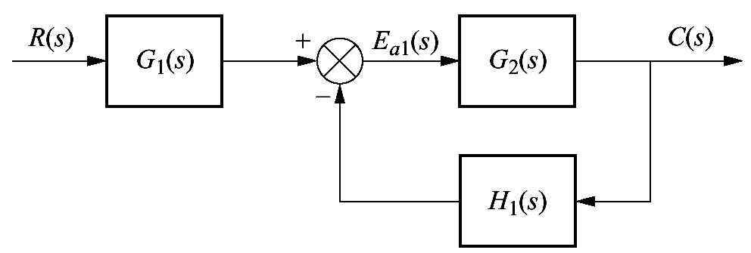
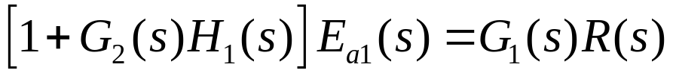
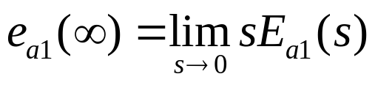
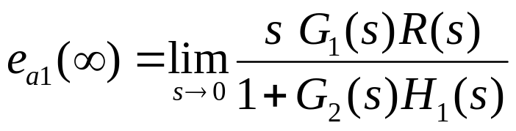
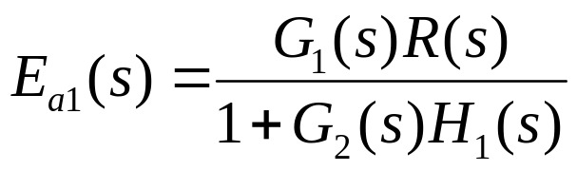
Steady-State value of the actuating signal, E_{a1}
no restriction that the input and output units be the same
Applying final value theorem:

Slide 21
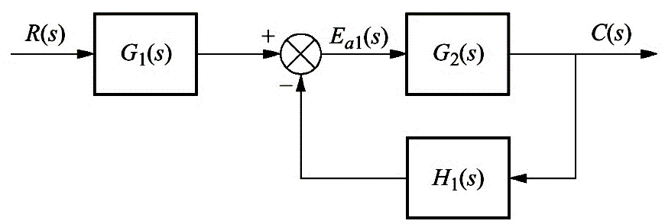
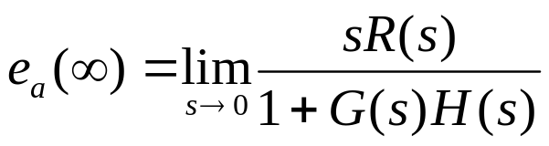


Steady-State Actuating Signal for Nonunity Feedback Systems
Example 7.9
PROBLEM: Find the steady-state actuating signal for the system shown in the Figure for a unit step input. Repeat for a unit ramp input.
For step input R(s)=1/s
For ramp input R(s)=1/s²

Slide 22
7.7 Sensitivity

Slide 23
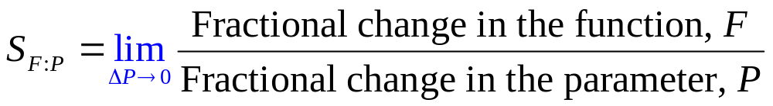
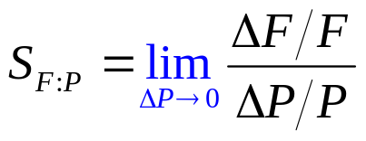
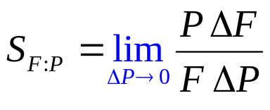
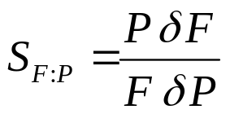
Definition
The extent to which changes in system parameters affect system transfer functions is called sensitivity.
OR
Sensitivity is ratio of the fractional change in the function to the fractional change in the parameter
as
the fractional change of the parameter approaches zero

Slide 24
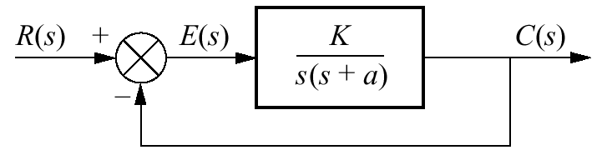




Example 7.10
Sensitivity of a Closed-Loop Transfer Function
PROBLEM: Given the system in the Figure, calculate the sensitivity of the closed-loop transfer function to changes in the parameter a. How would you reduce the sensitivity?
SOLUTION:
The closed-loop transfer function is
For any value of s, an increase in K reduces the sensitivity of the closed-loop transfer function to changes in the parameter a

Slide 25
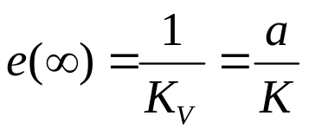
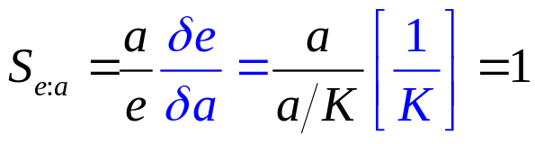
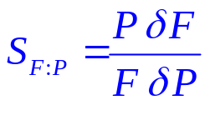
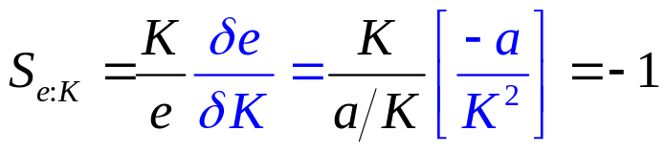
Example 7.11
Sensitivity of Steady-State Error with Ramp Input
PROBLEM: For the system shown in the Figure, find the sensitivity of the steady-state error to changes in parameter K and parameter a with ramp inputs.
SOLUTION:
The steady-state error for the system is
The negative sign indicates a decrease in e(∞) for an increase in K

Slide 26
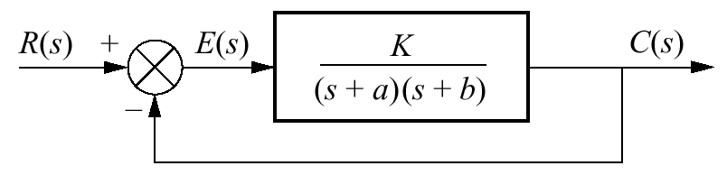



Example 7.12
Sensitivity of Steady-State Error with Step Input
PROBLEM: Find the sensitivity of the steady-state error to changes in parameter K and parameter a for the system shown in the Figure with a step input.
SOLUTION:
The steady-state error for this Type 0 system is

Slide 27

???

